Slide 1


Microprocessors and Assembly Language Spring 2020
Hamed Farbeh
farbeh@aut.ac.ir
Department of Computer Engineering
Amirkabir University of Technology
Lecture 13

Slide 2
Copyright Notice
Parts (text & figures) of this lecture are adopted from:
Arm Assembly Language Programming and Architecture, Volume 1, 1st edition, Muhammad Ali Mazidi, Sarmad Naimi, and Sepehr Naimi, MicroDigitalEd, 2013.
Microprocessors and Assembly Language, Spring 2020, AUT, Tehran, Iran

Slide 3
ARM Architecture and Assembly Language Programming
Microprocessors and Assembly Language, Spring 2020, AUT, Tehran, Iran

Slide 4
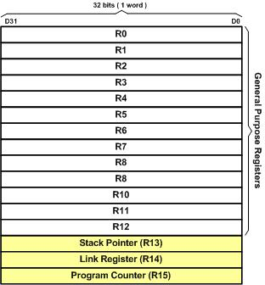
ARM Registers
Microprocessors and Assembly Language, Spring 2020, AUT, Tehran, Iran

Slide 5
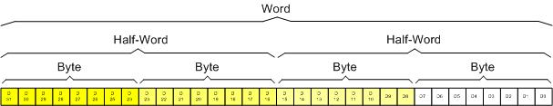
Registers Data Size
MSB: D31
LSB: D0
Microprocessors and Assembly Language, Spring 2020, AUT, Tehran, Iran

Slide 6
General Purpose Registers
13 GPRs
R0-R12 (32-bit)
Can be used by all arithmetic/logic instructions
Microprocessors and Assembly Language, Spring 2020, AUT, Tehran, Iran

Slide 7
ARM Instruction Format
A common format
Instruction destination, source1, source2
Source2 can be
A register
Immediate (constant)
Memory
Destination is often
A register
Memory
Microprocessors and Assembly Language, Spring 2020, AUT, Tehran, Iran

Slide 8
MOV Instruction
Copies data into register or from register to register
MOV Rn, Op2
load Rn register with Op2 (Operand2)
Op2 can be immediate (an 8-bit value)
Op2 can be a register Rm
Rn or Rm can be any of the registers R0 to R15
Microprocessors and Assembly Language, Spring 2020, AUT, Tehran, Iran

Slide 9
MOV Instruction: Examples
Load R2 with 0x25 (R2 = 0x25)
MOV R2,#0x25; 25 in hex
Notice the # before immediate values
Use “;” for comment (same as “//” in C)
For numbers in hex, put “0x” in front of the value
Put nothing for decimal
MOV R1,#50; 50 in decimal
Copy contents of R7 into R5 (R5 = R7)
MOV R5,R7
Microprocessors and Assembly Language, Spring 2020, AUT, Tehran, Iran

Slide 10
MOV Instruction: Examples
On moving a constant,
What happens to the rest of the register’s bits?
What about moving an immediate larger than 255?
MOV R1,#505
Will cause an error! Why?
Microprocessors and Assembly Language, Spring 2020, AUT, Tehran, Iran

Slide 11
ADD Instruction
ADD Rd,Rn,Op2
Add Rn to Op2 and store the result in Rd
Op2 can be immediate (an 8-bit value)
Op2 can be a register Rm
Microprocessors and Assembly Language, Spring 2020, AUT, Tehran, Iran

Slide 12
A Simple Program
Add 0x25 and 0x34
MOV R1,#0x25
MOV R7,#0x34
ADD R5,R1,R7
OR
MOV R1,#0x25
ADD R5,R1,#0x34
Microprocessors and Assembly Language, Spring 2020, AUT, Tehran, Iran

Slide 13
WHY
To Learn Assembly?!!!
Microprocessors and Assembly Language, Spring 2020, AUT, Tehran, Iran

